Slide 1
Packages and GUI Programming with Swing
Building Desktop Applications in Java

Slide 2
What We Will Learn
Understanding Packages
Understand the difference between AWT and Swing.
Master the Swing Component Hierarchy.
Create windows using JFrame and panels using JPanel.
Utilize Layout Managers to organize components.
Implement Event Handling (ActionListeners).
Understand the Event Dispatch Thread (EDT).
Build a functional desktop application.
Notes:
Speaker Notes: "By the end of this module, you won't just be writing console applications. You will be able to create interactive windows, handle user input, and understand the threading model required to keep GUIs responsive."

Slide 3
Understanding Java Packages
A namespace that organizes a set of related classes and interfaces.
Analogy: Think of packages as Folders on your computer.
Purpose:
Prevents naming conflicts.
Controls access (encapsulation).
Makes code easier to maintain.
Declaration: Must be the first line of your Java file.
package com.mycompany.guiapp;
Notes:
Visual Suggestion:
Diagram showing a file system folder structure mapped to package names (e.g., folder com -> mycompany -> guiapp).
Speaker Notes: "Before we write any Swing code, we need to know where to put it. A package is simply a way to group related files. In a GUI application, you might have one package for views, one for controllers, and one for models."

Slide 4
Avoiding Naming Conflicts
Java has thousands of built-in classes. Sometimes they have the same name.
Classic Example: List
java.awt.List (AWT GUI component)
java.util.List (Collection interface)
Without Packages/Imports: The compiler doesn't know which List you mean.
Solution: Fully qualified names or specific imports
// Ambiguous without imports
List myList = new List();
// Clear with imports
import java.util.List;
import java.awt.List; // Cannot import both with wildcards!
Notes:
Visual Suggestion:
Warning icon next to code showing a compiler error: "Reference to List is ambiguous."
Speaker Notes: "This is critical in Swing. You will often use java.util for logic (ArrayLists) and java.awt or javax.swing for UI. If you import both using *, your code will break if you use a class name that exists in both."

Slide 5
The import Statement
Allows you to use classes without typing the full package name.
Specific Import (Recommended)
import javax.swing.JFrame;
import javax.swing.JButton;
Wildcard Import (Use with Caution):
import javax.swing.*;
Rule: import statements come after package and before class.
Notes:
Visual Suggestion:
Code snippet showing the correct order: package -> import -> class.
Speaker Notes: "For learning Swing, import javax.swing.*; is convenient. However, in professional development, specific imports are preferred because they make it clear exactly which classes are being used and avoid the naming conflicts we just discussed."

Slide 6
GUI: History: AWT vs. Swing
AWT (Abstract Window Toolkit):
Java 1.0.
Heavyweight: Uses native OS components (buttons look like Windows buttons on Windows, Mac buttons on Mac).
Limited components, prone to bugs across platforms.
Swing:
Java 1.2 (part of JFC - Java Foundation Classes).
Lightweight: Written entirely in Java; draws its own pixels.
Pluggable Look & Feel: Can mimic native OS or use a custom style.
Richer set of components (JTable, JTree, JTabbedPane).
Notes:
Visual Suggestion:
Side-by-side screenshot of an AWT button vs. a Swing button on different OSs.
Speaker Notes: "Think of AWT as a wrapper around the operating system's UI. Swing is a custom painting engine. This is why Swing apps look consistent regardless of the OS, unless we tell them otherwise."

Slide 7
Controlling Access (Encapsulation)
Packages work closely with access modifiers.
public: Accessible from any other class.
private: Accessible only within the same class.
protected: Accessible within the package and subclasses.
Default (no modifier): Accessible only within the same package.
GUI Best Practice:
Make UI components private.
Provide public methods to update them.
public class LoginForm {
private JTextField passwordField;
public void clearForm() { ... }
}
Notes:
public class LoginForm {
private JTextField passwordField; // Hidden from other packages
public void clearForm() { ... } // Accessible API
}
Visual Suggestion:
Table comparing the four access levels (Class, Package, Subclass, World).
Speaker Notes: "Encapsulation is key. You don't want other parts of your program directly manipulating a button inside a window. Keep components private and expose public methods to change their state."

Slide 8
The Swing Architecture
java.awt.Component: The root abstract class.
java.awt.Container: A component that can hold other components.
javax.swing.JComponent: The base class for all Swing components.
Adds double buffering and keyboard handling.
Top-Level Containers:
JFrame (Window with borders/title).
JDialog (Popup window).
JApplet (Deprecated, web-based).
Notes:
Visual Suggestion:
A UML Class Diagram showing Component < Container < JComponent < JButton/JLabel.
Speaker Notes: "Everything in Swing is a Component. But not everything can hold other things. Only Containers can hold components. JFrame is the main window, but you usually add content to a JPanel inside the Frame."

Slide 9
Creating a Window (JFrame)
JFrame represents the main application window.
Key Setup Steps:
Instantiate the frame.
Set default close operation.
Set size (or pack()).
Set visibility to true.
Always start on the EDT.
JFrame frame = new JFrame("My App");
frame.setDefaultCloseOperation(JFrame.EXIT_ON_CLOSE);
frame.setSize(400, 300);
frame.setVisible(true);
Notes:
Speaker Notes: "A common mistake is forgetting setVisible(true). Another is forgetting the close operation, which leaves the program running in the background even after you click 'X'."
The Event Dispatch Thread (EDT)

Slide 10
Common Swing Components
All start with 'J'.
JLabel: Display text or images.
JButton: Clickable button.
JTextField: Single-line text input.
JTextArea: Multi-line text input (wrap in JScrollPane).
JCheckBox / JRadioButton: Selection controls.
JLabel label = new JLabel("Username:");
JTextField text = new JTextField(20);
JButton btn = new JButton("Submit");

Slide 11
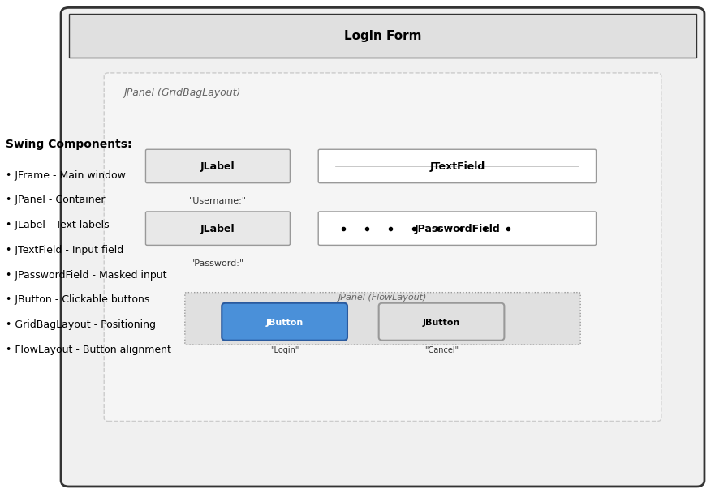
Swing Login Form component Layout.

Slide 12
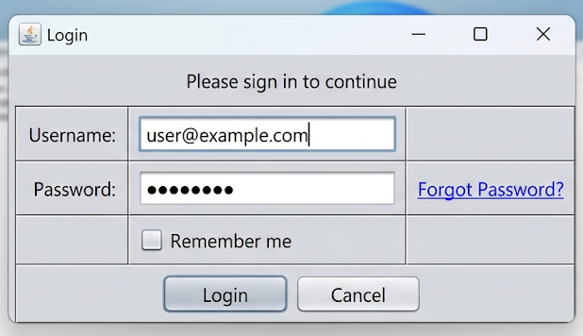
Screenshot of a simple login form showing swing components.
Notes:
Visual Suggestion:
Screenshot of a simple login form showing swing components.

Slide 13
Managing Component Placement
Why? Hard-coding coordinates (setBounds) is bad practice (doesn't scale, ignores OS font sizes).
Layout Managers automatically arrange components.
Common Layouts:
BorderLayout: North, South, East, West, Center (Default for JFrame).
FlowLayout: Left-to-right, wraps lines (Default for JPanel).
GridLayout: Grid of equal-sized cells.
BoxLayout: Single row or column.
Notes:
Speaker Notes: "Never use absolute positioning unless you have a very specific reason. Layout managers ensure your app looks good when the user resizes the window."

Slide 14
Layout Manager
BorderLayout:java
frame.setLayout(new BorderLayout());
frame.add(new JButton("North"), BorderLayout.NORTH);
frame.add(new JButton("Center"), BorderLayout.CENTER);
GridLayout:java
JPanel panel = new JPanel(new GridLayout(2, 2)); // 2 rows, 2 cols
panel.add(new JButton("1"));
panel.add(new JButton("2"));
Nested Layouts:
Combine panels with different layouts to create complex UIs.

Slide 15
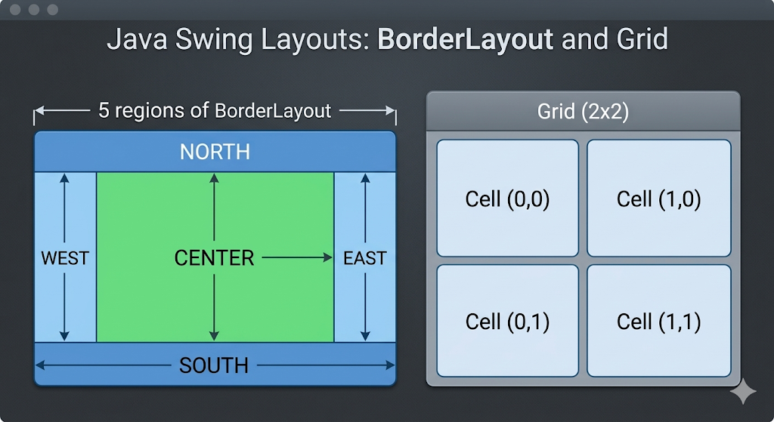
Diagram showing the 5 regions of BorderLayout and a 2x2 grid.

Slide 16
The Delegation Event Model
How Events Work
Source: The component (e.g., JButton).
Event: An object describing the change (e.g., ActionEvent).
Listener: An interface that waits for the event (e.g., ActionListener).
Registration: component.addListener(this)
Flow:
User clicks button.
Button creates ActionEvent.
Button notifies registered ActionListener.
actionPerformed method executes.
Notes:
Visual Suggestion:
Sequence diagram: User -> Button -> Event Object -> Listener Method.

Slide 17
Implementing Listeners
Handling Button Clicks
Option 1: Class implements ActionListener.
Option 2: Anonymous Inner Class (Common for simple UIs).
Option 3: Lambda Expression (Java 8+).
// Lambda Approach
button.addActionListener(e -> {
String text = textField.getText();
label.setText("Hello " + text);
});
Notes:
Speaker Notes: "Lambdas make Swing code much cleaner. The variable e represents the ActionEvent. Inside this block is where your business logic lives."

Slide 18
Menus & Standard Dialogs
Menus: JMenuBar, JMenu, JMenuItem.
Added to JFrame via setJMenuBar().
Dialogs: JOptionPane.
Quick popups for messages or input.
JOptionPane.showMessageDialog(frame, "Save Successful!");
String input = JOptionPane.showInputDialog("Enter Name:");
int confirm = JOptionPane.showConfirmDialog(frame, "Exit?");

Slide 19
Project Structure
Organizing a GUI Project
Don't put all classes in the default package.
Recommended Structure
src/
└── com/
└── myapp/
├── Main.java (Entry point)
├── view/ (JFrames, JPanels)
├── controller/ (ActionListeners, Logic)
└── model/ (Data classes)
Benefits
Separates UI from Logic (MVC Pattern).
Easier to scale as the app grows.
Notes:
Visual Suggestion:
Screenshot of the Project View in IntelliJ or Eclipse showing this folder structure.
Speaker Notes: "As your GUI gets complex, putting everything in one file is a nightmare. Start good habits early. Separate your UI code (View) from your logic (Controller)."

Slide 20
Common Mistakes
Package Pitfalls to Avoid
❌ The Default Package:
Never leave out the package declaration in serious projects.
Classes in the default package cannot be imported by classes in other packages.
❌ Naming Conflicts:
Do not name your class String, System, or Frame.
❌ Circular Dependencies:
Package A imports Package B, and Package B imports Package A.
✅ Best Practice:
Use lowercase for package names (e.g., com.example.app).
Use CamelCase for class names.
Notes:
Visual Suggestion:
Checkmark/Cross icon list comparing Bad vs. Good practices.
Speaker Notes: "The default package is fine for a 50-line test script, but for a Swing application, always define a package. It saves you from headaches when you try to compile multiple files later."

Slide 21
The Event Dispatch Thread (EDT)
Thread Safety in Swing
Swing is NOT thread-safe.
All UI updates must happen on the Event Dispatch Thread.
Problem: Long-running tasks (DB calls, downloads) freeze the UI if done on EDT.
Solution:
Start UI on EDT: SwingUtilities.invokeLater(...).
Run heavy tasks in background threads (SwingWorker).
SwingUtilities.invokeLater(() -> {
new MyApp().createAndShowGUI();
});
Notes:
Speaker Notes: "This is the most critical concept. If you block the EDT, the window becomes unresponsive ('Not Responding'). Never put Thread.sleep or heavy loops directly in an ActionListener."

Slide 22
Pluggable Look and Feel
Swing allows changing the UI skin at runtime.
System Look: Matches the OS.
Nimbus: Modern Java look (included in JDK).
CrossPlatform: Java's default (Metal).
try {
UIManager.setLookAndFeel(
UIManager.getSystemLookAndFeelClassName());
} catch (Exception e) { e.printStackTrace(); }
Java's Must be set before creating any components.

Slide 23
Putting It All Together
Task: Create a Temperature Converter.
Requirements:
JFrame titled "Converter".
JTextField for input.
Two JButtons (C to F, F to C).
JLabel to show result.
Use BorderLayout.
Handle invalid input (try-catch).
Launch on EDT.
Notes:
Speaker Notes: “pause here and try to code this. It touches on layout, components, events, and parsing logic."

Slide 24
Summary & Next Steps
Summary:
Swing is lightweight and mature.
Use Layout Managers, not absolute positioning.
Respect the Event Dispatch Thread.
Use Listeners for interaction.
Modern Alternatives:
JavaFX: Newer standard for Java desktop.
Web Technologies: Electron, React, etc. (Industry trend).
Resources:
Oracle Swing Tutorial docs.
"Core Java Volume II" (Horstmann).
Notes:
Speaker Notes:
"Swing is still used in massive enterprise systems (IDEs like IntelliJ, banking tools). While new projects might use JavaFX or Web, understanding Swing teaches you fundamental event-driven architecture."

